Slide 1
DURAL VENOUS SINUSES
BY
DR. OJEWALE A.O

Slide 2
Outline
Introduction
Characteristics & Functions
Classification
Applied anatomy

Slide 3
Intro’
They are endothelium-lined venous channels formed between the endosteal and meningeal layers of the dura mater.
They possess neither valves nor muscular tissue
They receive blood from veins of the brain and drain this into the internal jugular veins (IJV)
They are numerous and commonly found where dural processes are attached.

Slide 4
Characteristics & Functions
They are lined with endothelium
Devoid of muscular coat and valves
Projection of arachnoid granulation into it for cerebrospinal fluid (CSF) absorption.
Connected to valveless emissary veins to maintain an equilibrium of internal and external venous pressure.
Drain the blood from the brain, meninges, internal ear and bones of skull via the cerebral veins and CSF from the subarachnoid space via the arachnoid villa.

Slide 5
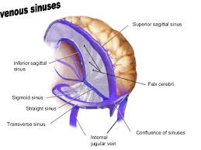
Classification of DVS
Unpaired dural venous sinuses include
Superior sagittal sinus
Inferior sagittal sinus
Straight sinus
Occipital sinus, and basilar sinus.
Paired dural venous sinuses include
Transverse sinuses
Sigmoid sinuses
Cavernous sinuses
Sphenoparietal sinuses
Superior petrosal sinuses
Inferior petrosal sinuses, and intercavernous sinuses

Slide 6
Classification of DVS
PAIRED DVS
CAVERNOUS
SUP. & INF. PETROSAL
TRANSVERSE
SIGMOID
UNPAIRED DVS
SUP. & INF. SAGGITAL
STRAIGHT
OCCIPITAL
BASILAR

Slide 7
The superior sagittal sinus
It occupies the attached upper convex border of the falx cerebri.
It begins anteriorly at the crista galli or foramen cecum, and ends posteriorly at the confluence of the sinuses (near the internal occipital protuberance). Here, it usually deviates to the right, to continue as the transverse sinus.
It receives the superior cerebral veins, and numerous arachnoid granulations. CSF drains from the subarachnoid space into venous channels.

Slide 8
Cont’d
It also receives the parietal emissary veins, which connect it with the veins in the pericranium of the calvaria. When the foramen cecum is patent, this sinus also receives a vein from the nasal cavity.
It communicates with the venous lacunae via minute orifices. These lacunae, about three on each side of the superior sagittal sinus are lateral expansion of the superior sagittal sinus.

Slide 9
Confluence of sinuses
Confluence of sinuses is the dilated posterior end of the superior sagittal sinus.
It is usually located to the right of the internal occipital protuberance.
It receives the straight, occipital, and transverse sinuses. However, variations do occur in this respect as some of the above sinuses may not join the confluence of sinuses.

Slide 10
Inferior sagittal sinus
It occupies the posterior two-third of the concave, lower border of the falx cerebri.
It ends posteriorly by uniting with the great cerebral vein to form the straight sinus.
It receives veins from the falx cerebri and occasionally from the medial cerebral surfaces.
It is smaller than the superior sagittal sinus.
It increases in size from anterior posteriorly.

Slide 11
Straight sinus
It is located in the tentorium cerebelli (at the junction of the tentorium cerebelli with the falx cerebri); thus, it is sagittally disposed (in the median plane).
It commences anteriorly by the union of the great cerebral vein of Galen with the inferior sagittal vein.
It passes postero-inferiorly (in the median plane) from its commencement, and may terminate behind at the confluence of the sinuses. However, it usually continues directly with the transverse sinus (behind).

Slide 12
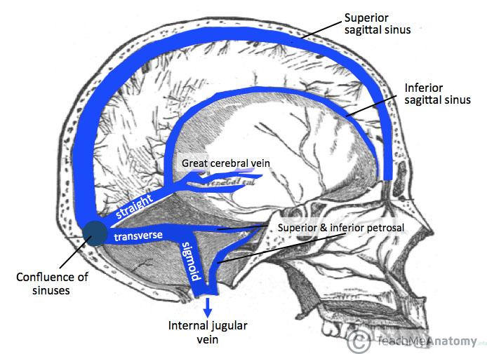

Slide 13
Cont’d
It receives the great cerebral and some superior cerebellar veins.

Slide 14
Occipital sinus
It is the smallest of the dural venous sinuses.
It occupies the attached margin of the falx cerebelli, in the posterior cranial fossa.
It commences near the foramen magnum below by the union of some minute vessels. It is linked, near its commencement, with the sigmoid sinus.
It ascends in the falx cerebelli, and terminates in the confluence of the sinuses.
It communicates below with the internal vertebral venous plexuses (located in the spinal epidural space), and it may be paired.

Slide 15
Basilar sinus (Basilar venous plexus
It consists of numerous interconnecting various channels located in the dura matter that overlies the clivus.
It interconnects the two inferior petrosal sinuses.
It communicates below with the internal vertebral venous plexus (in the vertebral canal).
It may also communicate with the cavernous and superior petrosal sinuses at its upper end.

Slide 16
Transverse sinuses
Each transverse sinus commences at the confluence of the sinuses, near the internal occipital protuberance.
It is usually the direct continuation of the superior sagittal sinus on the right, and of the straight sinus on the left.
It curves anterolaterally from its origin, along the attached posterolateral margin of the tentorium cerebelli, to the posterior end of the petrous temporal bone, where it turns down as the sigmoid sinus.

Slide 17
Cont’d
It grooves the squamous part of the occipital bone, and the mastoid angle of the parietal bone as it turns proximodistally.
It receives the inferior cerebellar, inferior cerebral, and diploic veins.
It communicates with the superior petrosal sinus where it becomes the sigmoid sinus.
It is larger on the side where it is continuous directly with the superior sagittal sinus (usually the right side); it also increase in size from proximal distally.

Slide 18
Sigmoid Sinuses
Each sigmoid sinus is the continuation of the transverse sinus (as the transverse sinus leaves the posterior attachment of the tentorium cerebelli).
It describes an S-shaped course as it runs inferomedially in a groove on the mastoid temporal bone (in the posterior cranial fossa).
Then, it finally turns forwards to becomes the internal jugular vein (by descending into the jugular foramen).
It communicates, via the mastoid and condylar emissary veins, with the pericranial veins.

Slide 19
Sphenoparietal Sinuses
Each sphenoparietal sinus is a small venous channel that runs medially, close to the posterior margin of the lesser wing of the sphenoid.
It ends in the anterior part of the cavernous sinus.
It receives tributaries from adjacent part of the dura. Occasionally, it receives the frontal branch of the middle meningeal vein.

Slide 20
Superior Petrosal Sinuses
Each superior petrosal sinus lies along the attached anterolateral margin of the tentorium cerebelli, on the superior border of the petrous temporal bone.
It extends posterolaterally (on the petrous temporal bone) from the posterosuperior part of the cavernous sinus to the terminal part of the transverse sinus (where the latter continues as the sigmoid sinus).
It lies above the trigeminal nerve (near its commencement at the cavernous sinus)

Slide 21
Cont’d
It drains the cavernous sinus into the sigmoid sinus.
It receives the inferior cerebral, superior cerebellar, and tympanic veins.
It communicates with the inferior petrosal, and basilar sinuses.

Slide 22
Inferior Petrosal Sinuses
Each inferior petrosal sinus commences at the posteroinferior end of the cavernous sinus.
It passes backwards, downwards, and laterally, in the groove between the petrous temporal bone, and basilar occipital bone.
It traverses the anterior part of the jugular foramen to terminate in the internal jugular vein.
It receives the labyrinthine, pontine, and cerebellar veins.

Slide 23
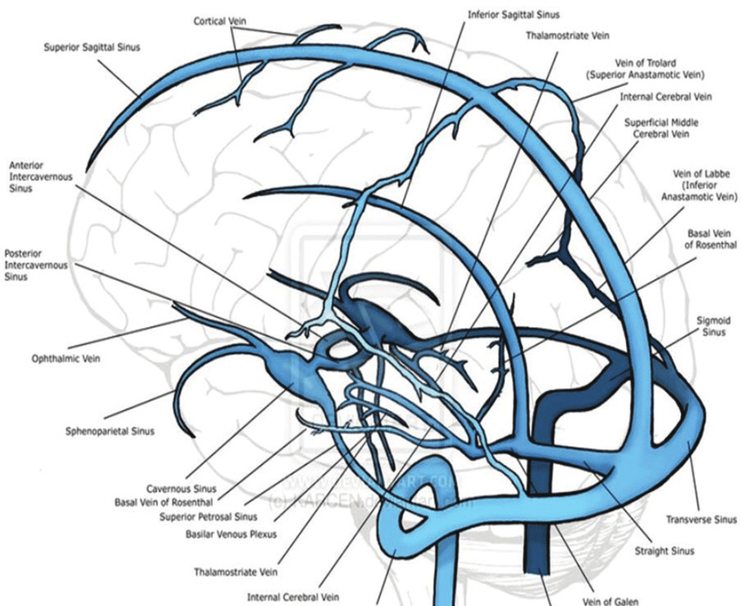

Slide 24
Intercavernous Sinuses
The intercavernous sinuses include anterior and posterior intercavernous sinuses; they are located in the anterior and posterior attached margins of the diaphragma sellae respectively.
Interconnect the right and left cavernous sinuses.
Receive the inferior intercavernous sinuses (located deep to the hypophysis cerebri in the floor of the hypophyseal fossa).

Slide 25
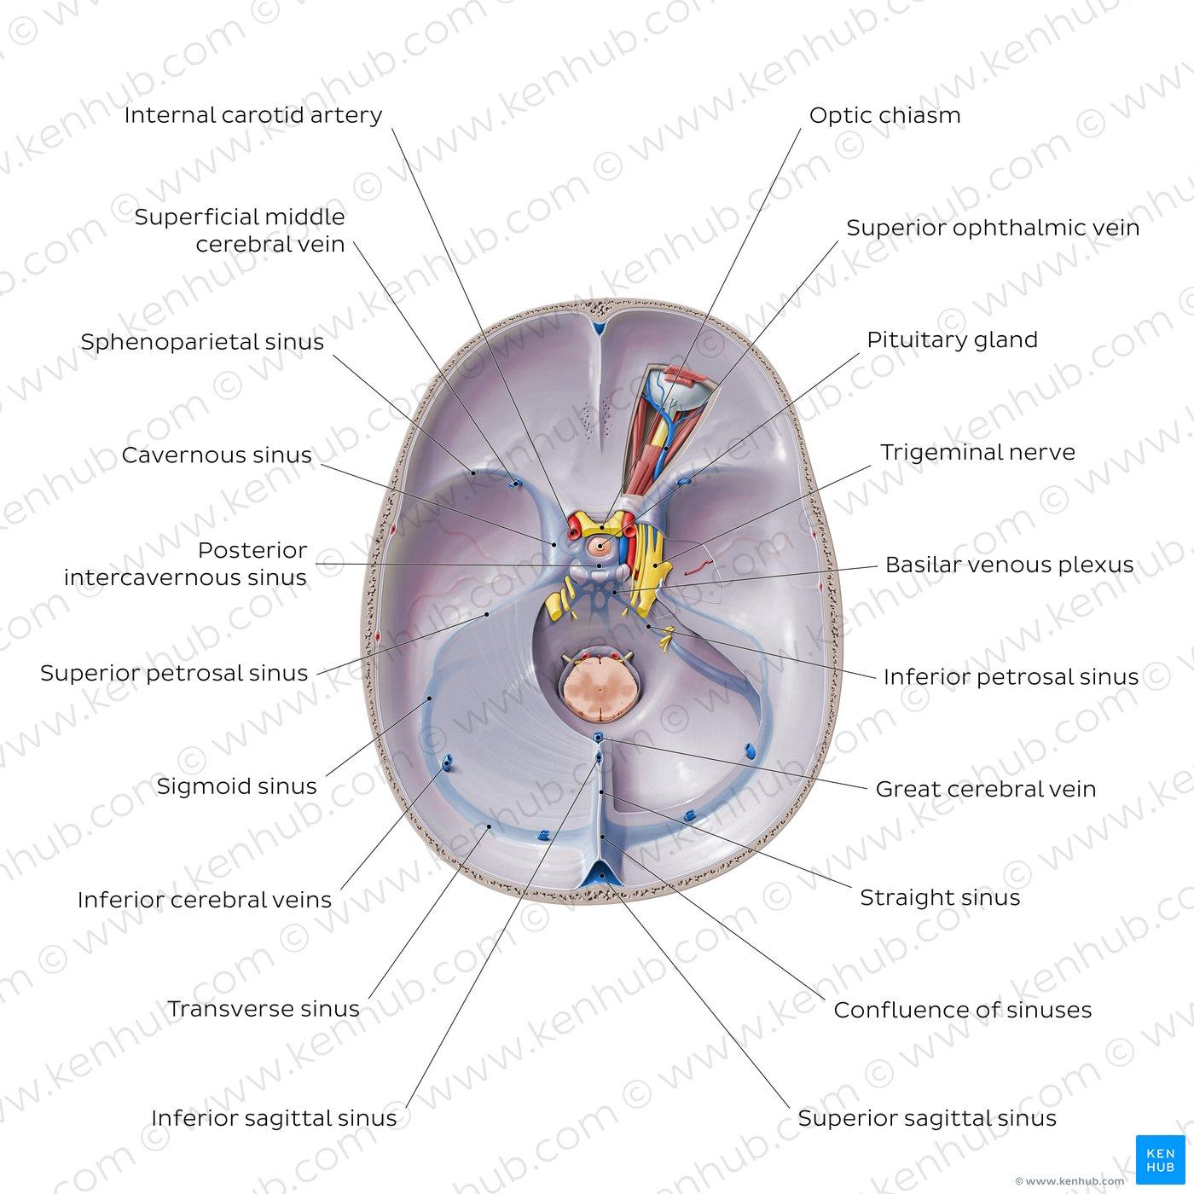

Slide 26
Cavernous sinuses
Each cavernous sinus
is located on each side of the body of the sphenoid bone.
Consists of several minute veins interconnected with one another. These give the sinus a reticulated, plexiform, and labyrinthine appearance.
Extends from the superior orbital fissure anteriorly to the apex of the petrous temporal bone posteriorly.
Measures about 2 cm in length and 1 cm in width.

Slide 27
Cont’d
Is joined to the opposite cavernous sinus by the anterior and posterior intercavernous sinuses.
Transmits some vital structures (nerves and artery) through it, and in its lateral wall.
Receives the superior and inferior ophthalmic, inferior cerebral and superficial middle cerebral veins. The sphenoparietal sinus of its own side also joins it anteriorly.

Slide 28
The cavernous sinus drains into the
Internal jugular vein, via the inferior petrosal sinus.
Transverse sinus, via the superior petrosal sinus.
Facial vein, via the superior ophthalmic vein.
Pterygoid plexus of veins, via emissary veins that traverse the foramina ovale and lacerum and the sphenoidal foramen.
Opposite cavernous sinus, via the intercavernous sinus.

Slide 29
Structures that pass through the cavernous sinus include
Internal carotid artery
Internal carotid plexus (of sympathetic nerves).
Abducent nerve

Slide 30
Structures that traverse the lateral wall of the cavernous sinus include, from above downwards;
Oculomotor motor
Trochlear nerve
Ophthalmic nerve (1st division of trigeminal nerve).
Maxillary nerve (2nd division of trigeminal nerve).

Slide 31
The flowing of the blood in dural sinus
Sup. Sagittal sinus
Inf. Sagittal sinus
Straight sinus
Confluence of sinuses
Transverse sinus
Sup. petrosal sinus
Sigmoid sinus
Cavernous sinus
Inf. Petrosal sinus
Internal jugular vein

Slide 32
Applied Anatomy
A pulsating orbital swelling (pulsating exophthalmos) may suggest leakage of the internal carotid artery into the cavernous sinus (e.g. following an accident).
Thrombophlebitis of the facial vein may give rise to thrombophlebitis of the cavernous sinus, owing to the communication between the facial vein and cavernous sinus (via the superior ophthalmic vein and pterygoid plexus).

Slide 33
Cont’d
Thrombophlebitis of the dural sinuses may also arise from infections of the scalp.
Suppuration in the danger triangle of the face, paranasal sinuses, and upper parts of the nasal cavities may produce septic thrombosis of the cavernous sinus.
Septic thrombosis of the cavernous sinus may result in inflammation of the meninges- acute meningitis.

Slide 34
Cont’d
Infections and cancer cells from certain pelvic, abdominal, and thoracic organs (e.g. prostate gland) may spread to the cerebral meninges and brain via the internal vertebral venous plexuses. The internal vertebral venous plexuses communicate with the basilar and occipital venous sinuses (through the foramen magnum).
The oculomotor, trochlear, ophthalmic, maxillary and abducent nerves are at risk in injuries that involve the cavernous sinus.

Slide 35


Slide 36
BLOOD SUPPLY OF THE BRAIN
BY
DR OJEWALE A.O

Slide 37
Outline
Intro’
Vertebral artery & Its branches
Internal carotid artery & Its branches
Basilar artery & Its branches
Branches of the main arteries of the brain
Arterial circle of Willis & Its formation
Applied Anatomy

Slide 38
INTRO’
The blood supply to the brain is provided by four arteries: two vertebral arteries and two internal carotid arteries.
The two vertebral arteries enter the skull through the foramen magnum and unite at the lower border of the pons to form the basilar artery, which ascends in the midline on the ventral surface of the pons and at its upper border terminates by dividing into right and left posterior cerebral arteries.

Slide 39
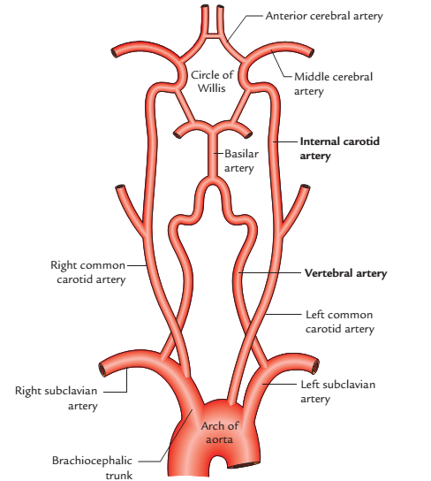
Four arteries supplying the brain

Slide 40
Vertebral Artery
The vertebral artery is one of the principal arteries which supplies the brain. It is the first and largest branch of the first part of the subclavian artery.
The vertebral artery arises from the upper aspect of the first part of the subclavian artery, runs vertically upwards to enter the foramen transversarium of the transverse process of C6. After emerging from the foramen transversarium of C1, it winds backwards around the lateral mass of the atlas and enters the cranial cavity through foramen magnum.

Slide 41
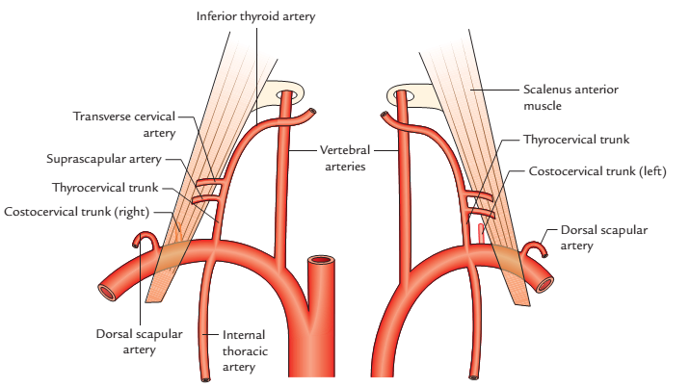
Branches of the right and left subclavian arteries

Slide 42
In the cranial cavity, it unites with the vertebral artery of the opposite side at the lower border of the pons to form the basilar artery.
The vertebral artery is divided into four parts:
First (cervical) part: It extends from origin to foramen transversarium of C6 vertebra. This part lies in the scalenovertebral triangle.
Second (vertebral) part: It lies within the foramen transversaria of upper six cervical vertebrae.
Third (suboccipital) part: It extends from foramen transversarium of C1 vertebra to the foramen magnum of skull. This part lies within the suboccipital triangle.

Slide 43
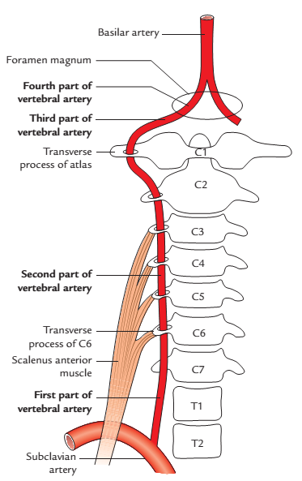
Cont’d
Fourth (intracranial) part: It extends from foramen magnum to the lower border of the pons.
Course and parts of the vertebral artery

Slide 44
Branches
In the neck (cervical branches)
Spinal branches: They arise from the second (vertebral) part and enter the vertebral canal through intervertebral foramina to supply the upper five or six cervical segments of the spinal cord.
Muscular branches: They arise from the first and third parts of the vertebral artery. Those from the first part, supply deep muscles of the neck and those from the third part, supply the muscles of the suboccipital triangle.

Slide 45
Cont’d
In the cranial cavity (cranial branches): They arise from the 4th part. These are:
Meningeal branches.
Posterior spinal artery.
Anterior spinal artery.
Posterior inferior cerebellar artery.
Medullary branches.

Slide 46
In the cranial cavity, each vertebral artery gives rise to:
Meningeal branches are small and supply the dura matter of the posterior cranial fossa (cerebellar fossa) including the falx cerebelli.
A posterior spinal artery, which descends through the foramen magnum to the spinal cord.
An anterior spinal artery, which unites with its fellow, anterior to the medulla, to form a single trunk that descends through the foramen magnum.

Slide 47
Cont’d
A posterior inferior cerebellar artery, which runs onto the inferior cerebellar surface, to supply it; it also supplies the medulla oblongata and the choroid plexus of the 4th ventricle.
Medullary arteries, which are several minute branches which supply the medulla oblongata.

Slide 48
Internal Carotid Artery

Slide 49
Internal Carotid Artery
Each internal carotid artery enters the cranial cavity through carotid canal and the superior part of the foramen lacerum. It then takes a sinuous course through the cavernous sinus, pierces the dural roof of the sinus, and ends immediately lateral to the optic chiasma in the region of anterior perforated substance by dividing into a larger middle cerebral artery and a smaller anterior cerebral artery.

Slide 50
Cont’d
The course of the internal carotid artery is divisible into four parts: (1) cervical, (2) petrous, (3) cavernous and (4) cerebral.
Cervical part, which ascends in the neck, medial to the internal jugular vein (carotid sheath) and the vagus nerve.
Petrous part, which traverses the carotid canal (in the petrous temporal bone) to enter the cranial cavity (by passing superomedially above the cartilage that covers the foramen lacerum).

Slide 51
Cont’d
Cavernous part: From the carotid canal, the artery enters the cavernous sinus through the upper part of the foramen lacerum. Here, the artery has a sinuous course and is separated from the blood in the cavernous sinus by the endothelium. This part of the artery is also called as the “carotid siphon”. The abducent nerve is related to the internal carotid artery closely in this course.

Slide 52
Cont’d
Cerebral part: which passes to the region of the anterior perforated substance, where it divides into anterior and middle cerebral arteries; the former is involved in the formation of the arterial circle of Willis.

Slide 53
Branches of the Cerebral Part of Internal Carotid Artery
Ophthalmic artery arises from internal carotid artery immediately after it comes out of cavernous sinus and makes a U-shaped bend. The ophthalmic artery enters the orbit through optic canal to supply structures of the orbit including eyeball.
Posterior communicating artery arises close to the termination of the internal carotid artery.

Slide 54
Cont’d
Posterior communicating artery runs backwards and anastomoses with the proximal part of the posterior cerebral artery.
Anterior choroidal artery is a long slender branch, which arises just distal to the origin of the posterior communicating artery. It courses backwards above and along the optic tract to enter the inferior horn of the lateral ventricle through the choroid fissure to end in the choroid plexus.

Slide 55
Cont’d
Anterior cerebral artery is a smaller terminal branch of the internal carotid artery. It runs forwards and medially above the optic nerve to the commencement of the median longitudinal cerebral fissure, where it comes very close to its fellow of the opposite side and gets joined with it by a short transverse anterior communicating artery.

Slide 56
Cont’d
The anterior cerebral artery then curves around the genu of corpus callosum. The artery continues along the upper surface of the corpus callosum and gives branches which supply the whole of the medial surfaces of the cerebral hemisphere above the corpus callosum as far back as the parieto-occipital sulcus.
Middle cerebral artery is the larger terminal branch of the internal carotid artery. It appears to be the direct continuation of the internal carotid artery.

Slide 57
Cont’d
The middle cerebral artery first runs laterally in the stem of the lateral sulcus and then turns backwards and upwards in the posterior ramus of the lateral sulcus, where it breaks up into frontal, parietal, and temporal branches, which emerge from the lateral sulcus and run towards the areas of their supply.

Slide 58
Basilar Artery

Slide 59
Basilar Artery
Is formed at the lower pontine border by the union of the two vertebral arteries.
Ascends in the median basilar sulcus, located on the ventral pontine surface; here it is surrounded by the pontine cistern.
Ends above at the upper pontine border, where it divides into right and left posterior cerebral arteries.

Slide 60
Branches of the Basilar Artery
Labyrinthine artery is a long slender branch which arises from anterior-inferior cerebellar artery. It accompanies the vestibulocochlear nerve and enters the internal auditory meatus to supply the internal ear. It is an end artery.
Then, it forms a loop over the flocculus of the cerebellum and peeps into the internal acoustic meatus for a variable distance lying below the 7th and 8th cranial nerves. After exit from the meatus, it supplies the anterolateral portion of the inferior surface of the cerebellum.

Slide 61
Cont’d
Anterior inferior cerebellar artery anastomoses with the posterior inferior cerebellar artery (a branch of the vertebral artery). After exits from the meatus, which supplies the anterolateral part of the inferior surface of the cerebellum
Posterior cerebral artery passes laterally along the superior border of the pons parallel to the superior cerebellar artery, curves around the midbrain to reach he medial surface of the cerebral hemisphere beneath the splenium of corpus callosum.

Slide 62
Cont’d
The artery gives off central branches into the ventral surface of the midbrain and temporal lobe of the corresponding cerebral hemisphere. Then it passes towards the occipital pole giving cortical branches.

Slide 63
Branches of the main arteries of the brain

Slide 64
Cerebral part of internal carotid artery | Cranial (fourth) part of vertebral artery | Basilar artery
Ophthalmic artery | Meningeal arteries | Anterior inferior cerebellar artery
Anterior cerebral artery | Anterior spinal artery | Labyrinthine artery
Middle cerebral artery | Posterior spinal artery | Pontine arteries
Posterior communicating artery | Posterior inferior cerebellar artery | Superior cerebellar artery
Anterior choroidal artery | Medullary arteries | Posterior cerebral artery

Slide 65
Arterial Circle of Willis

Slide 66
Arterial Circle of Willis
Is located in the interpeduncular cistern, at the base of the brain.
Surrounds the optic chiasma, tuber cinereum, mamillary bodies, posterior perforated substance, and the infundibular stalk.
Provides a form of central anastomoses which ensures adequate supply of blood to the cerebrum.

Slide 67
Formation
The circle of Willis is formed: Anteriorly, by the anterior communicating and the right and left anterior cerebral arteries.
Posteriorly, by the basilar artery dividing into two posterior cerebral arteries.
Posterolaterally on each side, by the posterior communicating artery connecting the internal carotid artery with the posterior cerebral artery.

Slide 68
Cont’d
The anterior cerebral artery forms the anterolateral part on each side.
The lateral part is formed by the termination of internal carotid artery on each side.
The circle is completed posteriorly by the bifurcation of basilar artery into the right and left posterior cerebral arteries.

Slide 69
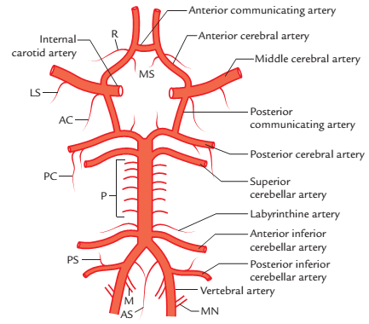
Circle of Willis (AS = anterior spinal artery, LS = lateral striate artery, M = medullary branches, MN = meningeal branches, MS = medial striate arteries, P = pontine branches, PC = posterior choroidal artery, PS = posterior spinal artery, R = recurrent artery of Heubner, AC = anterior choroidal artery

Slide 70
APPLIED ANATOMY
The charcot’s artery of cerebral haemorrhage is especially susceptible to haemorrhage.
Bleeding of the charcot’s artery (and other striate arteries) will damage the corpus striatum and internal capsule; this will produce severe motor dysfunctions.
Damage to the internal capsule (following cerebro-vascular accident) will produce spastic paralysis of the contralateral limbs- contralateral hemiplegia.

Slide 71
Cont’d
Thromboses in the cerebral arteries would also produce devastating motor and sensory deficits.
Thromboses in the posterior cerebral artery would adversely affect the visual cortex (except the macular area that is supplied by the middle cerebral artery). This would result in homonymous hemianopsia.
Thromboses in the middle cerebral artery would produce bilateral deafness (owing to lesions of the auditory area).

Slide 72
Cont’d
Contralateral hemiplegia and hemianaesthesia could also arise from the thromboses of the middle cerebral artery (as the motor and somatosensory cortices are adversely affected).
In thromboses of the middle cerebral artery, the lower limb loci of the motor and somatosensory cortices are spared (as these are supplied by the anterior cerebral artery).

Slide 73
Cont’d
Thrombosis in the posterior inferior cerebellar branch of the vertebral artery will produce a lateral medullary syndrome.
In lateral medullary syndrome, the vestibular and cochlear nuclei are damaged; the nuclei solitarius and ambigus are also affected, which the attendant loss of sensory and motor functions.

Slide 74
Cont’d
Superior cerebellar artery arises close to the superior border of the pons, runs laterally below the oculomotor nerve (which is interposed between this artery and the posterior cerebral artery) and winds round the cerebral peduncle below the trochlear nerve to reach the superior surface of the cerebellum, which it supplies.

Slide 75
Cont’d
Thrombosis of the anterior spinal artery will adversely affect the corticospinal tracts, hypoglossal nuclei and nerves, and the medial lemniscus; the clinical features presented in this condition are collectively termed medial medullary syndrome.
Cerebral thrombosis most commonly affects the middle cerebral artery or its main branches because it is a direct continuation of the internal carotid artery.

Slide 76
Cont’d
Posterior cerebral artery, this takes part in the formation of the arterial circle of Willis, at the base of the brain.

Slide 77
Clinical significance of the Circle of Willis
Normally, there is little or no mixing of blood streams of (a) two vertebral arteries in the basilar artery, (b) two anterior cerebral arteries in the anterior communicating artery, and (c) internal carotid and posterior cerebral arteries in the posterior communicating artery. Therefore, right half of the brain is supplied by right vertebral and right internal carotid arteries and left half of the brain is supplied by left vertebral and left internal carotid arteries.

Slide 78
Cont’d
In addition, if one of the major arteries forming the circle of Willis is blocked, the circle of Willis provides the various alternative routes for collateral circulation like an arterial traffic circle.

Slide 80
THANK YOU, ALL FOR LISTENING.

